Slide 1
Big Data Open Source Software and Projects
More on Software Stack
(only one Part)
I590 Data Science Curriculum
August 16 2014
Geoffrey Fox
gcf@indiana.edu
http://www.infomall.org
School of Informatics and Computing
Digital Science Center
Indiana University Bloomington

Slide 2
A Reminder
HPC-ABDS
Integrating High Performance Computing with Apache Big Data Stack
Shantenu Jha, Judy Qiu, Andre Luckow
http://hpc-abds.org/kaleidoscope/

Slide 3
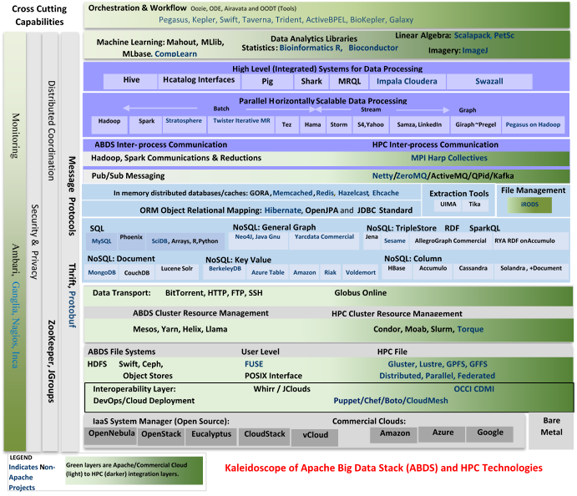
HPC-ABDS
~140 Capabilities
>40 Apache
Green layers have strong HPC Integration opportunities
Goal
Functionality of ABDS
Performance of HPC

Slide 5
Maybe a Big Data Initiative would include
Workflow: Python or Kepler
Data Analytics: Mahout, R, ImageJ, Scalapack
High level Programming: Hive, Pig
Parallel Programming model: Hadoop, Spark, Giraph (Twister4Azure, Harp), MPI; Storm, Kapfka or RabbitMQ (Sensors)
In-memory: Memcached
Data Management: Hbase, MongoDB, MySQL or Derby
Distributed Coordination: Zookeeper
Cluster Management: Yarn, Slurm
File Systems: HDFS, Lustre
DevOps: Cloudmesh, Chef, Puppet, Docker, Cobbler
IaaS: Amazon, Azure, OpenStack, Libcloud
Monitoring: Inca, Ganglia, Nagios

Slide 6







HPC ABDS SYSTEM (Middleware)
120 Software Projects
System Abstraction/Standards
Data Format and Storage
HPC Yarn for Resource management
Horizontally scalable parallel
programming model
Collective and Point to Point Communication
Support for iteration (in memory processing)
HPC ABDS
Hourglass
Application Abstractions/Standards
Graphs, Networks, Images, Geospatial ..
Scalable Parallel Interoperable Data Analytics Library (SPIDAL)
High performance Mahout, R, Matlab …..
High Performance Applications

Slide 7
SPIDAL (Scalable Parallel Interoperable Data Analytics Library)
Getting High Performance on Data Analytics
On the systems side, we have two principles:
  The Apache Big Data Stack with ~140 projects has important
  broad functionality with a vital large support organization
  HPC including MPI has striking success in delivering high performance,
  however with a fragile sustainability model
There are key systems abstractions which are levels in HPC-ABDS software stack where Apache approach needs careful integration with HPC
  Resource management
  Storage
  Programming model -- horizontal scaling parallelism
  Collective and Point-to-Point communication
  Support of iteration
Data interface (not just key-value) but system also supports other important application abstractions
  Graphs/network
  Geospatial
  Genes
  Images, etc.

Slide 8
Iterative MapReduce
Implementing HPC-ABDS
Judy Qiu, Bingjing Zhang, Dennis Gannon, Thilina Gunarathne

Slide 9
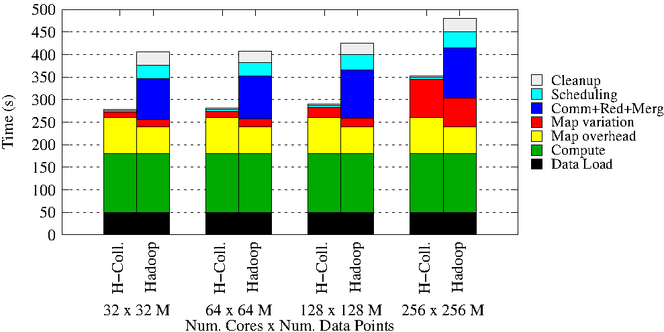
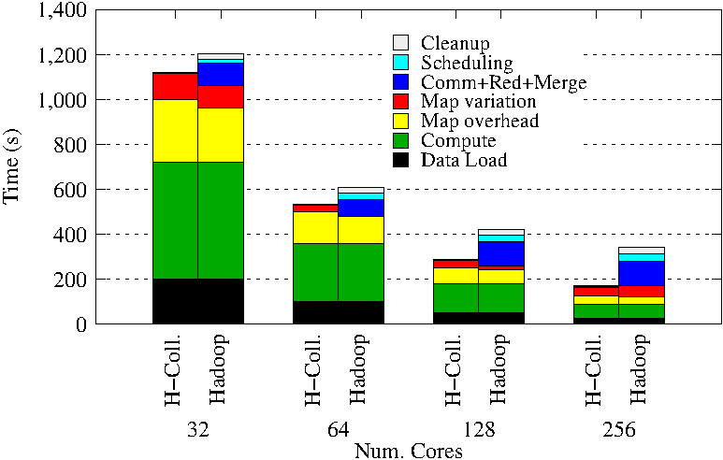
Using Optimal “Collective” Operations
Twister4Azure Iterative MapReduce with
enhanced collectives
  Map-AllReduce primitive and MapReduce-MergeBroadcast
Test on Hadoop (Linux) for Strong and Weak Scaling on K-means for up to 256 cores
Hadoop vs H-Collectives Map-AllReduce.
500 Centroids (clusters). 20 Dimensions. 10 iterations.

Slide 10
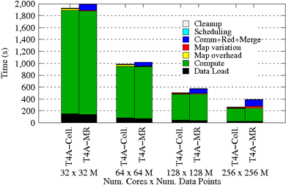
Using Optimal “Collective” Operations
Twister4Azure Iterative MapReduce with
enhanced collectives
  Map-AllReduce primitive and MapReduce-MergeBroadcast
Strong Scaling on K-means for up to 256 cores on Azure

Slide 11
Kmeans and (Iterative) MapReduce
Shaded areas are computing only where Hadoop on HPC cluster is fastest
Areas above shading are overheads where T4A smallest and T4A with AllReduce collective have lowest overhead
Note even on Azure Java (Orange) faster than T4A C# for compute

Slide 12
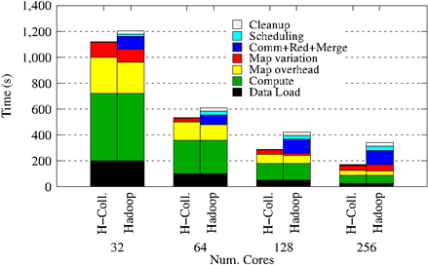
Collectives improve traditional MapReduce
Poly-algorithms choose the best collective
implementation for machine and collective at hand
This is K-means running within basic Hadoop but with
optimal AllReduce collective operations
Running on Infiniband Linux Cluster

Slide 13
Harp Design
Parallelism Model
Architecture
MapReduce Model
Map-Collective or Map-Communication Model
M
M
M
M
MapReduce Applications
Map-Collective
or Map-Communication Applications
M
M
M
M
Application
Shuffle
Harp
Optimal Communication
MapReduce V2
R
R
Framework
Resource Manager
YARN

Slide 14
Features of Harp Hadoop Plugin
Hadoop Plugin (on Hadoop 1.2.1 and
Hadoop 2.2.0)
Hierarchical data abstraction on arrays, key-values and graphs for easy programming expressiveness.
Collective communication model to support various communication operations on the data abstractions (will extend to Point to Point)
Caching with buffer management for memory allocation required from computation and communication
BSP style parallelism
Fault tolerance with checkpointing

Slide 15
WDA SMACOF MDS (Multidimensional Scaling) using Harp on IU Big Red 2
Parallel Efficiency: on 100-300K sequences
Best available MDS (much better than that in R)
Java
Harp (Hadoop plugin)
Cores =32 #nodes
Conjugate Gradient (dominant time) and Matrix Multiplication

Slide 16
Mahout and Hadoop MR – Slow due to MapReduce
Python slow as Scripting; MPI fastest
Spark Iterative MapReduce, non optimal communication
Harp Hadoop plug in with ~MPI collectives
Increasing Communication
Identical Computation

Slide 17
Lessons / Insights
Integrate (don’t compete) HPC with
“Commodity Big data”
(Azure to Amazon to
Enterprise Data Analytics)
  i.e. improve Mahout; don’t compete with it
  Use Hadoop plug-ins rather than replacing Hadoop
Enhanced Apache Big Data Stack HPC-ABDS has ~140 members
We illustrated ways we had used HPC features to improve application performance

